Slide 1

Software Development Methodologies
Notes:
Add images, write speech, meme at the end? Practical tool screenshot/more details on tools

Slide 2


Light talk authors
Mikalai Karamach
Senior Software Engineer
Danila Varatyntsev,
Senior Software Engineer

Slide 3
Software Development Life cycle
Planning
The Software Development Life Cycle (SDLC) – methodology with clearly defined processes for creating software.
Popular SDLC models:
Waterfall
Spiral
Scrum
Kanban
Maintenance
Analysis
SDLC
Testing
Design
Coding
Notes:
Dive into history https://scrumtrek.ru/blog/agile-scrum/3406/agile-history-1/
+ Discuss that work is not only development

Slide 4
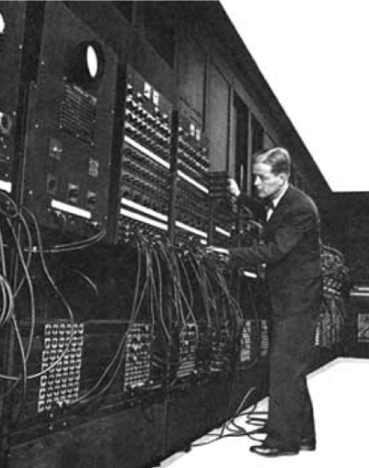
History
Projects have always exceeded budgets;
The implementation of the project has always exceeded the agreed time;
The final software inefficiently solved the task assigned to several gears (slowed down, instability, etc.);
The result was loss of quality;
Projects were unmanageable and code was difficult to follow.
Notes:
Dive into history https://scrumtrek.ru/blog/agile-scrum/3406/agile-history-1/
+ Discuss that work is not only development

Slide 5
Waterfall
Requirements analysis
System design
Development
Testing
Deployment
Maintenance

Slide 6
Waterfall – pros and cons
Advantages:
Simple and easy to understand and use
Easy to manage
Works well for smaller projects where requirements are very well understood
Clearly defined stages
Disadvantages:
No working software is produced until late during the life cycle
High amounts of risk and uncertainty
Poor model for complex and long projects
Not suitable for the projects where requirements are changing
It is difficult to measure progress within stages
Adjusting scope during the life cycle can end a project
Integration is done as a “big-bang”. at the very end, which doesn't allow identifying any technological or business bottleneck or challenges early

Slide 7
Spiral
Spiral model combines waterfall advantages with the idea of iterative development.
Spiral focus is risk management
Software is developed in iterations. Iteration stages:
Gathering requirements
Risk identification and mitigation
Implementation & Testing
Review and plan the next iteration
Advantages
Lower risks compared to Waterfall
Flexibility in requirements
Produces working software faster
Disadvantages
Complex model
Expensive
Difficult time management
Complex risk management

Slide 8
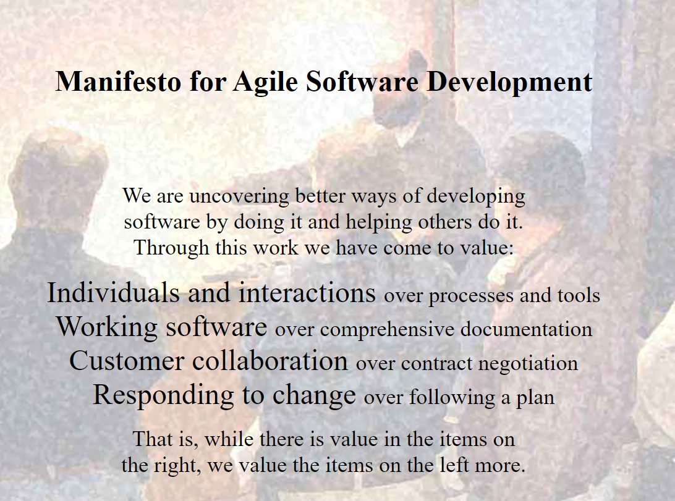
Agile
Agile – is a philosophy or mindset, not a SDLC. It’s based on 4 values and 12 principles (agilemanifesto.org). Agile is a way, not the goal
Values:
Individuals and interactions over processes and tools
Working software over comprehensive documentation
Customer collaboration over contract negotiation
Responding to change over following a plan
Included methodologies:
Kanban
Scrum
Lean software development
Dynamic systems development method (DSDM)
Crystal

Slide 9
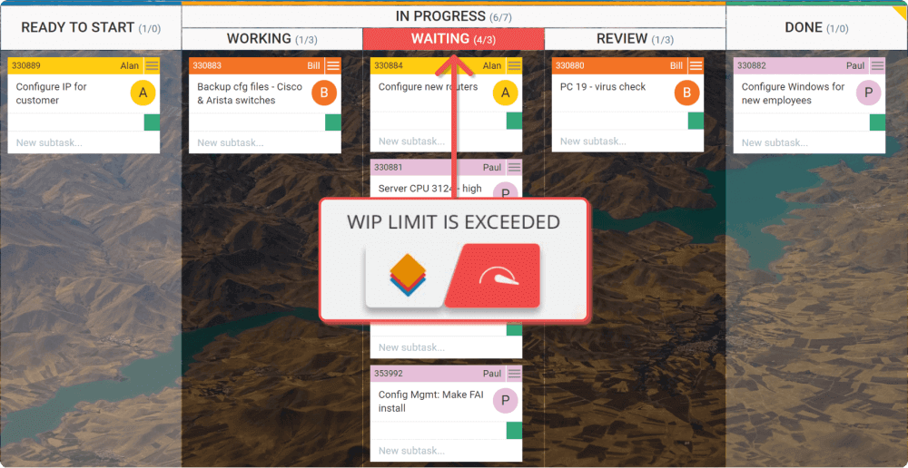
How to Kanban?
Principles:
Start With What You Do Now
Agree to Pursue Incremental, Evolutionary Change
Encourage Acts of Leadership at All Levels
Visualize the Workflow using Kanban board
Limit Work In Progress (WIP)
Manage Flow
Make Process Policies Explicit
Notes:
Include Tools

Slide 10
Kanban – pros and cons
Advantages:
Easy to use, because it needs just a simple whiteboard
Continuous development
Adaptability
Collaboration
Reduces costs
Low overhead, no meetings specified
Disadvantages:
Require stable plans
Timeless (no deadlines)
Require regular updates for Kanban board
Can’t be use in isolation

Slide 11
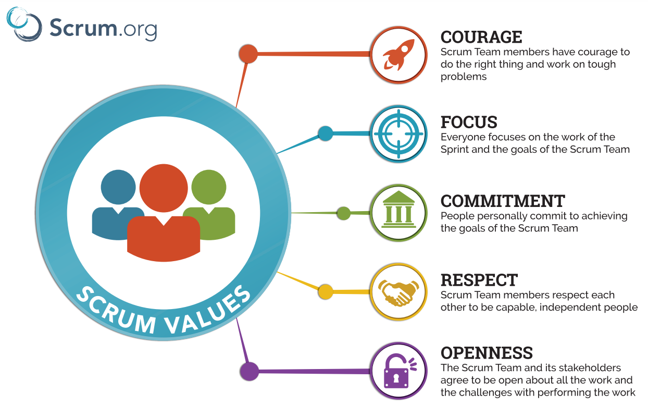
Scrum
Scrum is a framework for getting work done, where agile is a mindset
Principles:
Control over the empirical process
Self-organizing teams
Time-boxed
Collaboration
Value-based prioritization
Iterative development

Slide 12
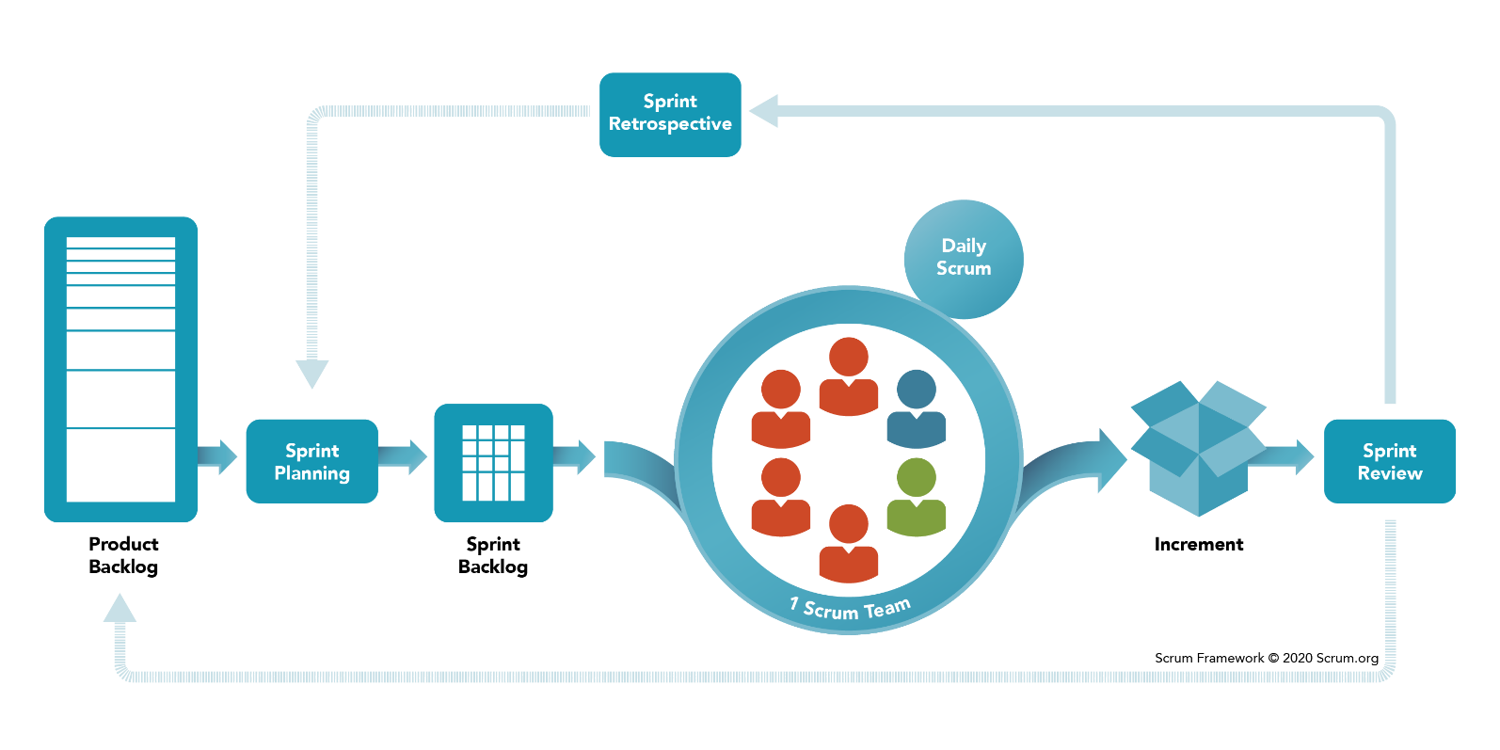
How to Scrum?
Scrum roles:
Product Owner (PO)
Scrum master
Development team
Scrum ceremonies:
Sprint
Sprint planning
Daily scrum or stand-up
Sprint review
Backlog refinement (Grooming)
Scrum artifacts:
Product Goal
Sprint Goal
Definition of Done
Notes:
Include Tools!

Slide 13
Scrum – pros and cons
Advantages:
It's adaptable and flexible.
It encourages creative approaches.
It involves low costs.
It usually leads to better quality work.
It improves customer satisfaction.
It typically results in more satisfied employees.
Disadvantages:
It requires the use of small teams.
It requires experienced personnel.
It can be difficult to integrate with a classic project management approach.
It may require major transformations within the organization.
It can be difficult to scale.

Slide 14
Scrum vs Kanban
 | Scrum | Kanban
Origin | Software development | Toyota manufacturing
Ideology | Learn through experiences, self-organize and prioritize, and reflect on wins and losses to continuously improve | Use visuals to improve work-in-progress
Cadence | Regular, fixed-length sprints (1-4 weeks) | Continuous flow
Practices | Sprint planning, sprint, daily scrum, sprint review, sprint retrospective | Visualize the flow of work, limit work-in-progress, manage flow, incorporate feedback loops
Roles | Product owner, scrum master, developer | No required roles

Slide 15
Additional topic to think
Estimation techniques
Metrics
Conflicts resolving
Engineering Excellence

Slide 16
QA
Do you have any questions?

Slide 17
Pictures

